Slide 1
Chapter 7. Cluster Analysis
What is Cluster Analysis? A unsupervised ML
Types of Data in Cluster Analysis
A Categorization of Major Clustering Methods
Partitioning Methods
Hierarchical Methods
Density-Based Methods
Grid-Based Methods
Model-Based Methods
Clustering High-Dimensional Data
Constraint-Based Clustering
Outlier Analysis
Summary
Notes:
To do the cluster Analysis for understanding your data to talk about 4 patioining methd and 5 hierarchical method we can determined which data method and know which customer wasting your resources and do not contribute your revenue

Slide 2
What is Cluster Analysis?
Cluster: a collection of data objects
Similar to one another within the same cluster
Dissimilar to the objects in other clusters
Cluster analysis
Finding similarities between data according to the characteristics found in the data and grouping similar data objects into clusters
Unsupervised learning: no predefined classes
Typical applications
As a stand-alone tool to get insight into data distribution
As a preprocessing step for other algorithms
Notes:
集群是為了做出分類 每集群中的資料都比較相同 反之異同

Slide 3
Clustering: Rich Applications and Multidisciplinary Efforts
Pattern Recognition
Spatial空間Data Analysis
Create thematic maps in GIS by clustering feature spaces
Detect spatial clusters or for other spatial mining tasks
Image Processing
Economic Science (especially market research)
WWW
Document classification
Cluster Weblog data to discover groups of similar access patterns
Notes:
How recently do the customer come to your shop
How frequency do your customer buy the merchandise

Slide 4
Examples of Clustering Applications
Marketing: Help marketers discover distinct groups in their customer bases, and then use this knowledge to develop targeted marketing programs
Land use: Identification of areas of similar land use in an earth observation database
Insurance: Identifying groups of motor insurance policy holders with a high average claim cost
City-planning: Identifying groups of houses according to their house type, value, and geographical location
Earth-quake studies: Observed earth quake epicenters should be clustered along continent faults
Notes:
營銷：幫助行銷人員發現其客戶群中的不同群體，然後利用這些知識制定有針對性的營銷計劃 土地利用：在地球觀測資料庫中確定類似土地利用的區域 保險：識別平均索賠成本較高的汽車保險保單持有人群體 城市規劃：根據房屋類型、價值和地理位置確定房屋組 地震研究：觀測到的地震震中應沿大陸斷層聚集

Slide 5
Quality: What Is Good Clustering?
A good clustering method will produce high quality clusters with
high intra-class similarity
low inter-class similarity
The quality of a clustering result depends on both the similarity measure used by the method and its implementation
The quality of a clustering method is also measured by its ability to discover some or all of the hidden patterns
Notes:
一個好的聚類方法將產生高品質的聚類 類內相似性高 類間相似性低 聚類結果的質量取決於方法使用的相似性度量及其實現 聚類方法的品質還取決於其發現部分或全部隱藏模式的能力

Slide 6
Measure the Quality of Clustering
Dissimilarity/Similarity metric: Similarity is expressed in terms of a distance function, typically metric: d(i, j)
There is a separate “quality” function that measures the “goodness” of a cluster.
The definitions of distance functions are usually very different for interval-scaled, boolean, categorical, ordinal ratio, and vector variables.
Weights should be associated with different variables based on applications and data semantics.
It is hard to define “similar enough” or “good enough”
the answer is typically highly subjective.
Notes:
相異性/相似性度量：相似度用距離函數表示，通常為度量：d（i， j） 有一個單獨的「品質」函數來衡量集群的「好壞」。 對於區間標度、布爾變數、類別變數、有序比率變數和向量變數，距離函數的定義通常非常不同。 權重應根據應用程式和數據語義與不同的變數相關聯。 很難定義“足夠相似”或“足夠好” 答案通常是高度主觀的。

Slide 7
Requirements of Clustering in Data Mining
Scalability
Ability to deal with different types of attributes
Ability to handle dynamic data
Discovery of clusters with arbitrary shape
Minimal requirements for domain knowledge to determine input parameters
Able to deal with noise and outliers
Insensitive to order of input records
High dimensionality
Incorporation of user-specified constraints
Interpretability and usability
Notes:
可擴展性 能夠處理不同類型的屬性 處理動態數據的能力 發現任意形狀的集群 確定輸入參數的領域知識的最低要求 能夠處理雜訊和異常值 對輸入記錄的順序不敏感 高維數(your data set has many many atribute 距離可以 合併使用者指定的約束(when you do the clustering want to set up a shop, ur want to found 人口很多的地方去開店，每個區域都人很多怎麼選定位置 根據使用者) 可解釋性和可用性(這個應該是根據個人)

Slide 8
Chapter 7. Cluster Analysis
What is Cluster Analysis?
Types of Data in Cluster Analysis
A Categorization of Major Clustering Methods
Partitioning Methods
Hierarchical Methods
Density-Based Methods
Grid-Based Methods
Model-Based Methods
Clustering High-Dimensional Data
Constraint-Based Clustering
Outlier Analysis
Summary

Slide 9
Data Structures
Data matrix
(two modes)
Dissimilarity matrix
(one mode)
Notes:
會有兩種形式的資料 用於cluster 分析
第一種 有很多屬性的資料 you have n different data column and p different date
第二種是已經分類、計算過 already calculated data 可以直接使用

Slide 10
Type of data in clustering analysis
Interval-scaled variables
Binary variables
Nominal, ordinal, and ratio variables
Variables of mixed types

Slide 11
Interval-valued variables
Standardize data
Calculate the mean absolute deviation:
where
Calculate the standardized measurement (z-score)
Using mean absolute deviation is more robust than using standard deviation

Slide 12
Similarity and Dissimilarity Between Objects
Distances are normally used to measure the similarity or dissimilarity between two data objects
Some popular ones include: Minkowski distance:
where i = (x_{i1}, x_{i2}, …, x_{ip}) and j = (x_{j1}, x_{j2}, …, x_{jp}) are two p-dimensional data objects, and q is a positive integer
If q = 1, d is Manhattan distance
Notes:
曼哈頓distance 每個街區的長寬都是1
Eculidean distance

Slide 13
Similarity and Dissimilarity Between Objects (Cont.)
If q = 2, d is Euclidean歐式 distance:
Properties性能
d(i,j) ≥ 0
d(i,i) = 0
d(i,j) = d(j,i)
d(i,j) ≤ d(i,k) + d(k,j)
Also, one can use weighted distance, parametric Pearson product moment correlation, or other disimilarity measures
Notes:
三角形 兩邊和大於第三邊

Slide 14
Binary Variables
Object j
A contingency table for binary data
Distance measure for symmetric binary variables:
Distance measure for asymmetric binary variables:
Jaccard coefficient (similarity measure for asymmetric binary variables):
Object i
Notes:
二進位數據的列聯表 對稱二元變數的距離測量： 非對稱二元變數的距離測量：差別在於不考慮d (total column) Jaccard 係數（非對稱二元變數的相似性度量）：

Slide 15
Dissimilarity between Binary Variables
Example
gender is a symmetric attribute
the remaining attributes are asymmetric binary
let the values Y and P be set to 1, and the value N be set to 0
Notes:
醫院做身體檢查 我們可以找到影響較大的參數
性別是對稱屬性 其餘屬性是非對稱二進位的(我們不考慮上一張投影片中分母的d (這邊指的是資料colum的數量)) 將值 Y 和 P 設置為 1，將值 N 設置為 0

Slide 16
Categorical Variables
A generalization of the binary variable in that it can take more than 2 states, e.g., red, yellow, blue, green
Method 1: Simple matching
m: # of matches, p: total # of variables
Method 2: use a large number of binary variables
creating a new binary variable for each of the M nominal states
Notes:
二元變數的泛化，它可以採用 2 種以上的狀態，例如紅色、黃色、藍色、綠色 方法一：簡單匹配 m：#个匹配项，p：總共#個變數 方法二：使用大量二元變數 為每個 M 名義狀態創建新的二進位變數

Slide 17
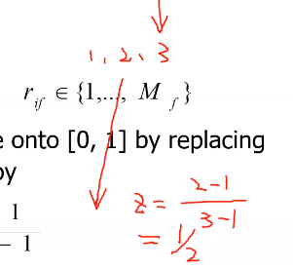
Ordinal Variables
An ordinal variable can be discrete or continuous
Order is important, e.g., rank
Can be treated like interval-scaled
replace x_{if} by their rank
map the range of each variable onto [0, 1] by replacing i-th object in the f-th variable by
compute the dissimilarity using methods for interval-scaled variables
Notes:
序數基礎
序數變數可以是離散的，也可以是連續的 順序很重要，例如，排名 可以像間隔縮放一樣處理 將 xif 替換為他們的等級 通過將第 f 個變數中的第 i 個物件替換為 使用區間尺度變數的方法計算相異性

Slide 18
Ratio-Scaled Variables
Ratio-scaled variable: a positive measurement on a nonlinear scale, approximately at exponential scale, such as Ae^{Bt} or Ae^{-Bt}
Methods:
treat them like interval-scaled variables—not a good choice! (why?—the scale can be distorted)
apply logarithmic transformation
y_{if} = log(x_{if})
treat them as continuous ordinal data treat their rank as interval-scaled
Notes:
比率標度變數：非線性標度上的正測量值，近似於指數標度，例如 AeBt 或 Ae-Bt。 方法： 將它們視為區間尺度變數 - 不是一個好的選擇！（為什麼?——比例可能會失真） 應用對數變換 yif = log（xif） 將它們視為連續序號數據，將其秩視為區間尺度

Slide 19
Variables of Mixed Types
A database may contain all the six types of variables
symmetric binary, asymmetric binary, nominal, ordinal, interval and ratio
One may use a weighted formula to combine their effects
f is binary or nominal:
δ_{ij}^{(f)} = 0 if x_{if} = x_{jf}=0 and variable f is asymmetric or one of x_{if ,} x_{jf} is missing, or δ_{ij}^{(f)} = 1 otherwise
f is interval-based: use the normalized distance
f is ordinal or ratio-scaled
compute ranks r_{if} and
and treat z_{if} as interval-scaled
Notes:
比較複雜的一個
我們不做 跳過 太難
資料庫可以包含所有六種類型的變數 對稱二進位、非對稱二進位、標稱、序數、區間和比率 可以使用加權公式來組合它們的效果 f 是二進位或標稱值： 如果 xif = xjf=0 且變數 f 不對稱或 xif 之一，則 δij（f） = 0，否則缺少 xjf，否則 δij（f） = 1 f 基於間隔：使用歸一化距離 f 是有序的或比率比例的 計算排名 rif 和 並將 ZIF 視為區間縮放

Slide 20
Example
A sample data set containing variable of mixed type
0
d(2,1) | 0
d(3,1) | d(3,2) | 0
d(4,1) | d(4,2) | d(4,3) | 0
Notes:
跳過

Slide 21
Object identifier | Test-1 (categorical) | Test-2 (ordinal) | Test-3 (ratio-scaled)
1 | Code-A | excellent | 445 (2.65)
2 | Code-B | fair | 22 (1.34)
3 | Code-C | good | 164 (2.21)
4 | Code-A | excellent | 1,210 (3.08)
0
0.75 | 0
0.25 | 0.5 | 0
0.25 | 1.0 | 0.87 | 0
At. 3’
0
1 | 0
1 | 1 | 0
0 | 1 | 1 | 0
0
1 | 0
0.5 | 0.5 | 0
0 | 1 | 0.5 | 0
0
1.31 | 0
0.44 | 0.87 | 0
0.43 | 1.74 | 0.87 | 0
At. 1
At. 2
At. 3
Notes:
跳過

Slide 22
0
0.92 | 0
0.58 | 0675 | 0
0.08 | 1.0 | 0.67 | 0
0
1 | 0
1 | 1 | 0
0 | 1 | 1 | 0
0
1 | 0
0.5 | 0.5 | 0
0 | 1 | 0.5 | 0
0
0.75 | 0
0.25 | 0.5 | 0
0.25 | 1.0 | 0.87 | 0
At. 1
At. 2
At. 3’
Notes:
跳過

Slide 23
Chapter 7. Cluster Analysis
What is Cluster Analysis?
Types of Data in Cluster Analysis
A Categorization of Major Clustering Methods
Partitioning Methods
Hierarchical Methods
Density-Based Methods
Grid-Based Methods
Model-Based Methods
Clustering High-Dimensional Data
Constraint-Based Clustering
Outlier Analysis
Summary

Slide 24
Major Clustering Approaches (I)
Partitioning approach:
Construct various partitions and then evaluate them by some criterion, e.g., minimizing the sum of square errors
Typical methods: k-means, k-medoids, CLARANS
Hierarchical approach:
Create a hierarchical decomposition of the set of data (or objects) using some criterion
Typical methods: Diana, Agnes, BIRCH, ROCK, CAMELEON
Density-based approach:
Based on connectivity and density functions
Typical methods: DBSACN, OPTICS, DenClue
Notes:
分區方法： 構造各種分區，然後通過一些標準來評估它們，例如，最小化平方誤差的總和 典型方法：k-means、k-medoids、CLARANS
階層方法： 使用某些條件創建數據集（或物件）的分層分解 典型方法：戴安娜、艾格尼絲、樺木、搖滾、駱駝
基於密度的方法： 基於連通性和密度函數 典型方法：DBSACN、OPTICS、DenClue

Slide 25
Major Clustering Approaches (II)
Grid-based approach:
based on a multiple-level granularity structure
Typical methods: STING, WaveCluster, CLIQUE
Model-based:
A model is hypothesized for each of the clusters and tries to find the best fit of that model to each other
Typical methods: EM, SOM, COBWEB
Frequent pattern-based:
Based on the analysis of frequent patterns
Typical methods: pCluster
User-guided or constraint-based:
Clustering by considering user-specified or application-specific constraints
Typical methods: COD (obstacles), constrained clustering
Notes:
基於網格的方法： 基於多級粒度結構 典型方法：STING、WaveCluster、CLIQUE 基於模型： 為每個聚類假設一個模型，並嘗試找到該模型彼此的最佳擬合 典型方法：EM、SOM、COBWEB 頻繁的基於模式： 基於對頻繁模式的分析 典型方法：pCluster 使用者引導或基於約束： 通過考慮使用者指定或特定於應用程式的約束進行聚類 典型方法：COD（障礙物）、約束聚類

Slide 26
Chapter 7. Cluster Analysis
What is Cluster Analysis?
Types of Data in Cluster Analysis
A Categorization of Major Clustering Methods
Partitioning Methods
Hierarchical Methods
Density-Based Methods
Grid-Based Methods
Model-Based Methods
Clustering High-Dimensional Data
Constraint-Based Clustering
Outlier Analysis
Summary

Slide 27
Hierarchical Clustering
Use distance matrix as clustering criteria. This method does not require the number of clusters k as an input, but needs a termination condition
Step 0
Step 1
Step 2
Step 3
Step 4
agglomerative
(AGNES)
a
a b
b
a b c d e
c
c d e
d
d e
e
divisive
(DIANA)
Step 4
Step 3
Step 2
Step 1
Step 0
Notes:
使用距離矩陣作為聚類條件。 此方法不需要簇數 k 作為輸入，但需要終止條件

Slide 28
AGNES (Agglomerative Nesting)
Introduced in Kaufmann and Rousseeuw (1990)
Implemented in statistical analysis packages, e.g., Splus
Use the Single-Link method and the dissimilarity matrix.
Merge nodes that have the least dissimilarity
Go on in a non-descending fashion
Eventually all nodes belong to the same cluster
Notes:
在Kaufmann和Rousseeuw（1990）中引入 在統計分析軟體包中實現，例如Splus 使用Single-Link方法和相異矩陣。 合併差異最小的節點 以非下降的方式繼續前進 最終，所有節點都屬於同一集群

Slide 29
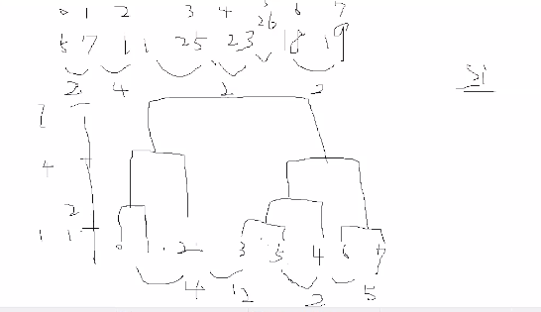
Dendrogram: Shows How the Clusters are Merged
Decompose data objects into a several levels of nested partitioning (tree of clusters), called a dendrogram.
A clustering of the data objects is obtained by cutting the dendrogram at the desired level, then each connected component forms a cluster.

Slide 30
Typical Alternatives to Calculate the Distance between Clusters
Single link: smallest distance between an element in one cluster and an element in the other, i.e., dis(K_{i}, K_{j}) = min(t_{ip}, t_{jq})
Complete link: largest distance between an element in one cluster and an element in the other, i.e., dis(K_{i}, K_{j}) = max(t_{ip}, t_{jq})
Average: avg distance between an element in one cluster and an element in the other, i.e., dis(K_{i}, K_{j}) = avg(t_{ip}, t_{jq})
Centroid: distance between the centroids of two clusters, i.e., dis(K_{i}, K_{j}) = dis(C_{i}, C_{j})
Medoid: distance between the medoids of two clusters, i.e., dis(K_{i}, K_{j}) = dis(M_{i}, M_{j})
Medoid: one chosen, centrally located object in the cluster
Notes:
單鏈路：一個簇中的元素與另一個簇中的元素之間的最小距離，即 dis（Ki， Kj） = min（tip， tjq）
完整連結：一個簇中的元素與另一個簇中的元素之間的最大距離，即 dis（Ki， Kj） = max（tip， tjq）
平均值：一個聚類中的元素與另一個聚類中的元素之間的平均距離，即 dis（Ki， Kj） = avg（tip， tjq）
質心：兩個簇的質心之間的距離，即dis（Ki， Kj） = dis（Ci， Cj）
等點：兩個簇的中間體之間的距離，即 dis（Ki， Kj） = dis（Mi， Mj） Medoid：集群中一個選定的、位於中心位置的物體

Slide 31
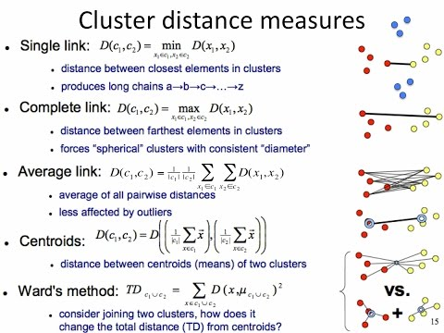
Notes:
Wards 就是上面的sum of square 去判斷哪幾個合起來會下降

Slide 32
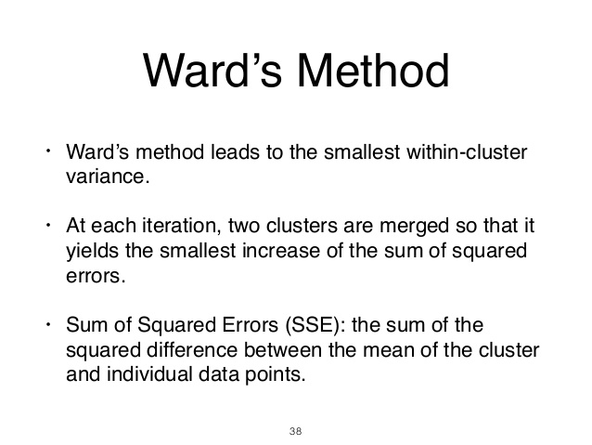

Slide 33
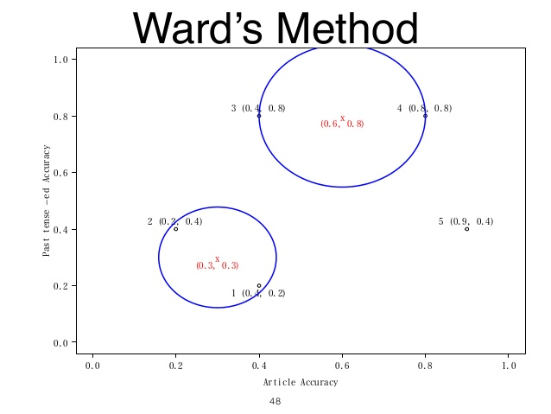

Slide 34
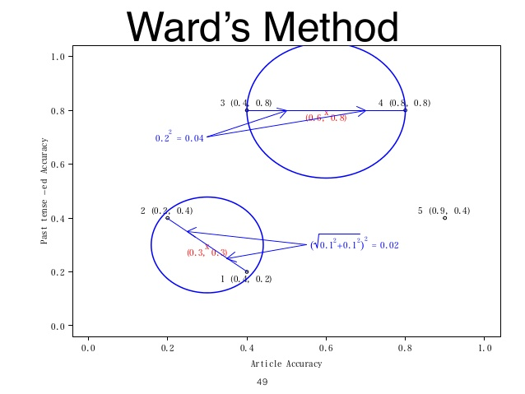

Slide 35
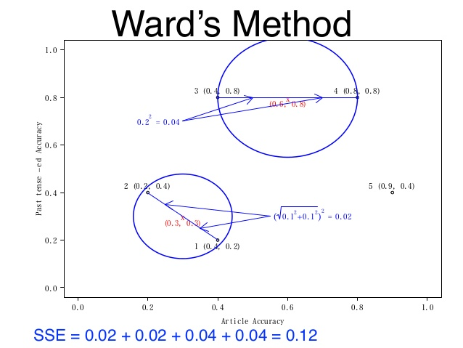

Slide 36
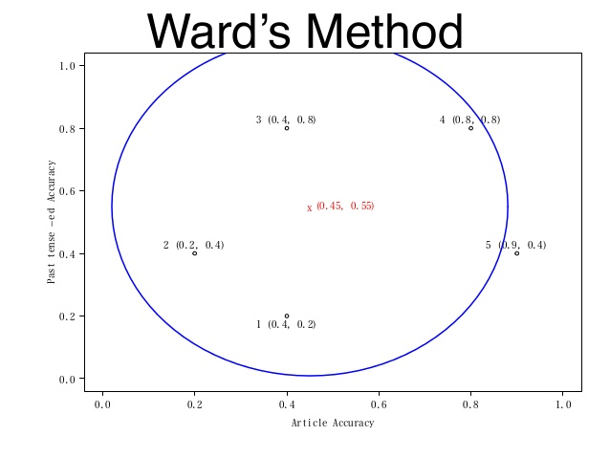

Slide 37
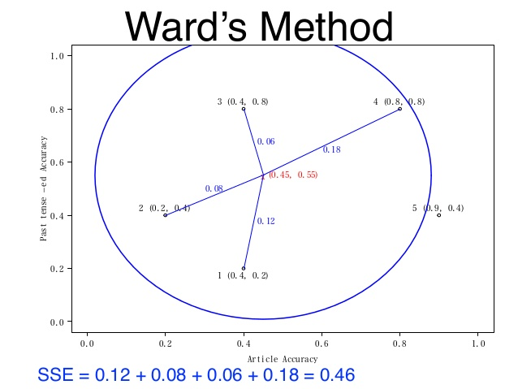

Slide 38
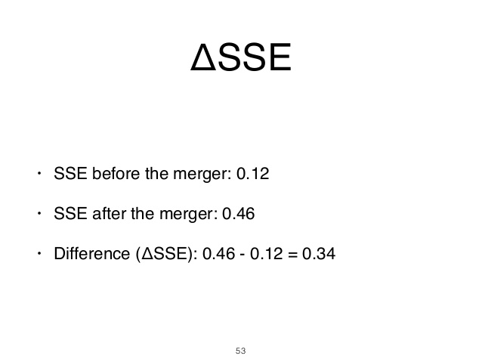

Slide 39
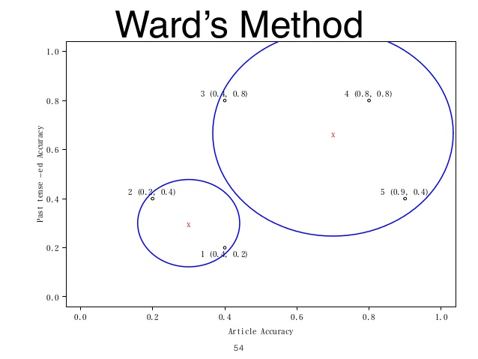

Slide 40
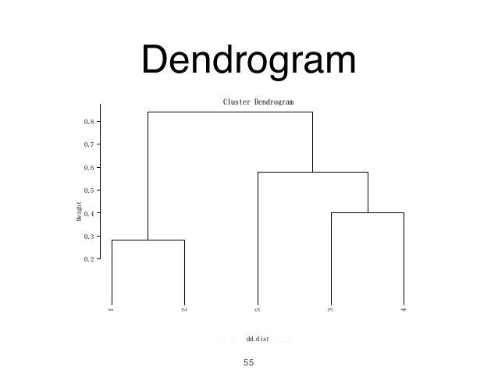

Slide 41
Centroid, Radius and Diameter of a Cluster (for numerical data sets)
Centroid: the “middle” of a cluster
Radius: square root of average distance from any point of the cluster to its centroid
Diameter: square root of average mean squared distance between all pairs of points in the cluster

Slide 42
Chapter 7. Cluster Analysis
What is Cluster Analysis?
Types of Data in Cluster Analysis
A Categorization of Major Clustering Methods
Partitioning Methods
Hierarchical Methods
Density-Based Methods
Grid-Based Methods
Model-Based Methods
Clustering High-Dimensional Data
Constraint-Based Clustering
Outlier Analysis
Summary

Slide 43
Partitioning Algorithms: Basic Concept
Partitioning method: Construct a partition of a database D of n objects into a set of k clusters, s.t., min sum of squared distance
Given a k, find a partition of k clusters that optimizes the chosen partitioning criterion
Global optimal: exhaustively enumerate all partitions
Heuristic methods: k-means and k-medoids algorithms
k-means (MacQueen’67): Each cluster is represented by the center of the cluster
k-medoids or PAM (Partition around medoids) (Kaufman & Rousseeuw’87): Each cluster is represented by one of the objects in the cluster
Notes:
分區方法：將一個資料庫 D 的 n 個物件的分區構造成一組 k 個簇，s.t.，最小平方和(t(is the data point belong to the data i ) 跟i是啥?)km 是你有kdiferent cluster m就是第一個center inter cluster error
給定一個 k，找到一個由 k 個簇組成的分區，該分區優化了所選的分區條件 全域最優：詳盡地枚舉所有分區 啟發式方法：k-means 和 k-medoids 演算法 k-means （MacQueen』67）：每個聚類由聚類的中心表示 k-medoids 或 PAM（圍繞 medoids 的分區）（Kaufman & Rousseeuw'87）：每個簇都由簇中的一個物件表示

Slide 44
The K-Means Clustering Method
Given k, the k-means algorithm is implemented in four steps:
Partition objects into k nonempty subsets
Compute seed points as the centroids of the clusters of the current partition (the centroid is the center, i.e., mean point, of the cluster)
Assign each object to the cluster with the nearest seed point
Go back to Step 2, stop when no more new assignment
Notes:
給定 k，k-means 演算法分四個步驟實現： 將物件劃分為 k 個非空子集 將種子點計算為當前分區的聚類的質心（質心是聚類的中心，即平均點） 將每個物件分配給具有最近種子點的集群 返回第 2 步，當沒有更多新分配時停止

Slide 45
The K-Means Clustering Method
Example
10
10
9
9
8
8
7
7
6
6
5
5
4
Assign each objects to most similar center
Update the cluster means
4
3
3
2
2
1
1
0
0
0
1
2
3
4
5
6
7
8
9
10
0
1
2
3
4
5
6
7
8
9
10
reassign
reassign
K=2
Arbitrarily choose K object as initial cluster center
Update the cluster means

Slide 46
Comments on the K-Means Method
Strength: Relatively efficient: O(tkn), where n is # objects, k is # clusters, and t is # iterations. Normally, k, t << n.
Comparing: PAM: O(k(n-k)² ), CLARA: O(ks² + k(n-k))
Comment: Often terminates at a local optimum. The global optimum may be found using techniques such as: deterministic annealing and genetic algorithms
Weakness
Applicable only when mean is defined, then what about categorical data?
Need to specify k, the number of clusters, in advance
Unable to handle noisy data and outliers
Not suitable to discover clusters with non-convex shapes
Notes:
強度：相對高效：O（tkn），其中 n 是 # 物件，k 是 # 集群，t 是 # 迭代。通常，k、t << n。 比較： PAM： O（k（n-k）2 ）， CLARA： O（ks2 + k（n-k）） 評論：通常終止於局部最優值。全域最優可以通過以下技術找到：確定性退火和遺傳演算法 弱點 僅當定義了均值時才適用，那麼分類數據呢？ 需要提前指定k，簇數 無法處理嘈雜的數據和異常值 不適合發現具有非凸形狀的聚類

Slide 47
Variations of the K-Means Method
A few variants of the k-means which differ in
Selection of the initial k means
Dissimilarity calculations
Strategies to calculate cluster means
Handling categorical data: k-modes (Huang’98)
Replacing means of clusters with modes
Using new dissimilarity measures to deal with categorical objects
Using a frequency-based method to update modes of clusters
A mixture of categorical and numerical data: k-prototype method
Notes:
k-means 的幾個變體，它們在 選擇初始 k 均值 相異性計算 計算聚類均值的策略 處理分類資料：k 模式 （Huang'98） 用模式替換集群的手段 使用新的相異度量來處理分類物件 使用基於頻率的方法更新集群的模式 分類數據和數值數據的混合：k原型法

Slide 48
What Is the Problem of the K-Means Method?
The k-means algorithm is sensitive to outliers !
Since an object with an extremely large value may substantially distort the distribution of the data.
K-Medoids: Instead of taking the mean value of the object in a cluster as a reference point, medoids can be used, which is the most centrally located object in a cluster.
10
10
9
9
8
8
7
7
6
6
5
5
4
4
3
3
2
2
1
1
0
0
1
2
3
4
5
6
7
8
9
10
0
0
1
2
3
4
5
6
7
8
9
10
Notes:
k-means 演演算法對異常值很敏感！ 由於具有極大值的物件可能會嚴重扭曲數據的分佈。 K-Medoids：可以使用中心點，而不是將聚類中物件的平均值作為參考點，中心點是聚類中最中心的物件。

Slide 49
The K-Medoids Clustering Method
Find representative objects, called medoids, in clusters
PAM (Partitioning Around Medoids, 1987)
starts from an initial set of medoids and iteratively replaces one of the medoids by one of the non-medoids if it improves the total distance of the resulting clustering
PAM works effectively for small data sets, but does not scale well for large data sets
CLARA (Kaufmann & Rousseeuw, 1990)
CLARANS (Ng & Han, 1994): Randomized sampling
Focusing + spatial data structure (Ester et al., 1995)

Slide 50
A Typical K-Medoids Algorithm (PAM)
Total Cost = 20
10
9
8
Arbitrary choose k object as initial medoids
Assign each remaining object to nearest medoids
7
6
5
4
3
2
1
0
0
1
2
3
4
5
6
7
8
9
10
K=2
Randomly select a nonmedoid object,O_{ramdom}
Total Cost = 26
Do loop
Until no change
10
10
9
Compute total cost of swapping
9
Swapping O and O_{ramdom}
If quality is improved.
8
8
7
7
6
6
5
5
4
4
3
3
2
2
1
1
0
0
1
2
3
4
5
6
7
8
9
10
0
0
1
2
3
4
5
6
7
8
9
10

